Slide 1

Computer Graphics
Dr. Lucy J. Gudino
Computer Science & Information Systems Group
Birla Institute of Technology & Science, Pilani, Goa Campus

Slide 2
Clipping and Polygon filling

Slide 3
Filled closed objects
Different types of Polygons
  Simple Convex
  Simple Concave
  Non-simple : self-intersecting
  With holes
Simple convex 2. simple concave 3. non-simple
        (self-intersection)

Slide 4
Area Fill Algorithms
Given the edges defining a polygon, and a color for the polygon, we need to fill all the pixels inside the polygon.
Two basic approaches
  Scan line approach:
    Determine the overlap intervals for scan lines that cross the area.
    Fill that area.
  Fill approach:
    start from a given interior position and paint outward from this point until we encounter the specified boundary conditions
Used to fill polygons, circles, ellipses and simple curves
Used to fill Complex objects and interactive painting systems

Slide 5
Contd…
Three different algorithms:
  1. Scan-line fill
  2. Boundary fill
  3. Flood fill

Slide 6
Scan-line polygon Fill Algorithm
Algorithm : Fill in polygons by computing intersections of boundaries with scan lines, and filling between pairs of intersections
  Assume scan line start from the left and is outside the polygon.
  When intersect an edge of polygon, start to color each pixel (because now we’re inside the polygon), when intersect another edge, stop coloring …
  Odd number of edges: inside
  Even number of edges: outside
out
in
out
in

Slide 7
Procedure
Find minimum enclosed rectangle
No. of scanlines= Ymax–Ymin + 1
For each scanline do
  Obtain intersection points of scanline with polygon edges.
  Sort intersections from left to right
  Form pairs of intersections from the list
  Fill within pairs
  Stop when scanline has reached Ymax

Slide 8
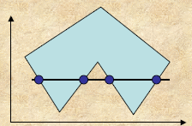
Contd…
Check if a point is within a Poly?
  Look left or right, and count the number of intersection points of the scanline with the edges of the Polygon.
  If the number is ODD, Points is Inside else Outside

Slide 9
How to handle vertices?
Can we count vertex twice?

Slide 10
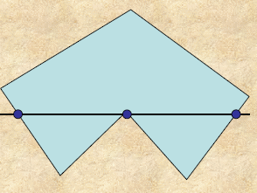
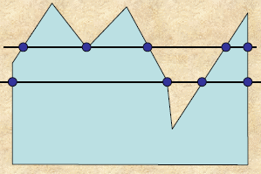
Contd…
No. of intersection in general is even
Intersection at Vertex needs special handling
Dealing with vertices : Two more cases
Case I : Case II :

Slide 11
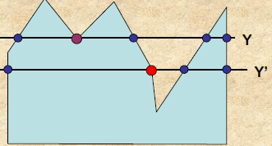
What is the difference between the intersection of the scanlines Y and Y’, with the vertices?
  For Y, the edges at the vertex are on the same side of the scanline, whereas for Y’ the edges are on either/both sides of the vertex.

Slide 12
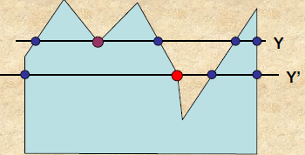
A B
C
D
E
Traverse along the polygon boundary clockwise (or anticlockwise)
Observe the relative change in Y-value of the edges on either side of the vertex (i.e. as we move from one edge to another).
  Check if y is monotonically increasing or decreasing.
  If direction changes, double intersection, otherwise single intersection.

Slide 13



Contd…
If the vertex is a local extrema, add two intersections for the scan line corresponding to such a shared vertex.
Must avoid this to happen in cases, such as:

Slide 14
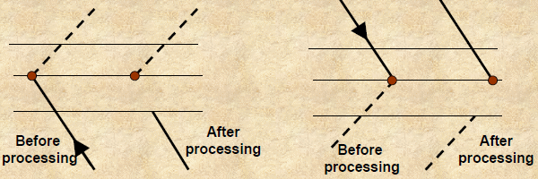
Contd…
To implement the above:
  While processing non-horizontal edges (generally) along a polygon boundary in any order, check to determine the condition of monotonically changing (increasing or decreasing) endpoint Y values.
  If so:
    Shorten the lower edge to ensure only one intersection point at the vertex.

Slide 15
Summary
Intersect scanline with polygon edges.
Fill between pairs of intersections
Basic Structure:
For y = Y_{min}to Y_{max}
  1) intersect scanline with each edge
  2) Sort intersections by increasing X
  3) Fill pairwise( int0->int1, int2->int3, … )

Slide 16
Contd…
Some special cases to make sure it works right.
Some concepts
  scanline coherence-values don't change much from one scanline to the next
    the coverage (or visibility) of a face on one scanline typically differs little from the previous one.
  edge coherence-edges intersected by scanline i are typically intersected by scanline i+1

Slide 17
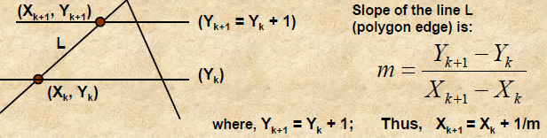
Contd…
Thus the intersection for the next scanline is obtained as:
X_{k+1}= round (X_{k}+ 1/m),
where m = ΔY/ΔX. How to implement this using integer arithmetic ?

Slide 18
Contd..
Take an example: m = ΔY/ΔX = 7/3.
  Set Counter, C = 0
  and counter increment, ΔC = ΔX = 3;
For the next three scan lines, successive values of C are : 3, 6, 9.
Thus only at 3rd scanline C > ΔY.
Xk is incremented by 1 only at 3rd scanline
and set C = C –ΔY = 9 –7 = 2.
Repeat the above step(s) till Yk reaches Ymax

Slide 19
Data structure used
SET: Sorted Edge table
  Contains all information necessary to process the scanlines efficiently.
  SET is typically built using a bucket sort, with a many buckets as there are scan lines.
  All edges are sorted by their Ymin coordinate. with a separate Y bucket for each scanline.
  Within each bucket, edges sorted by increasing X of Ymin point.
  Only non-horizontal edges are stored. Store these edges at the scanline position in the SET.

Slide 20
Contd…
Edge structure :sample record for each scanline
  (Ymax, Xmin, ΔX/ΔY, pointer to next edge)
AEL (Active edge List):Contains all edges crossed by a scanline at the current stage of iteration.
  This is a list of edges that are active for this scanline, sorted by increasing X intersections.
  Also called: Active Edge Table (AET).

Slide 21
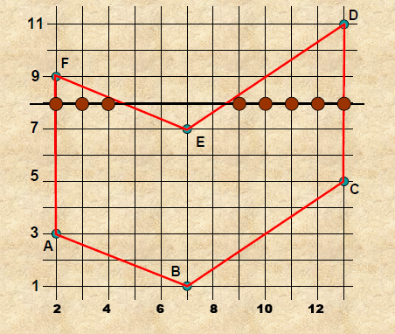
Example

Slide 22
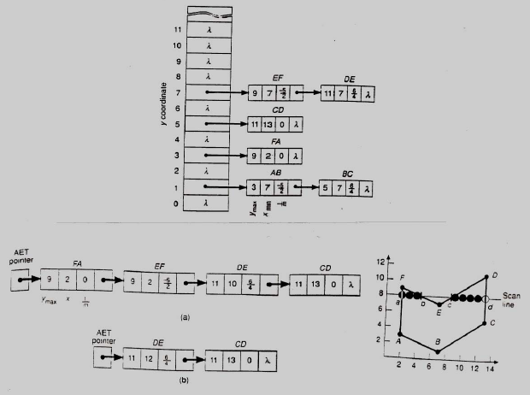

Slide 23
Processing Steps:
Set Y to smallest Y in SET entry (first non-empty bucket)
Initialize AET to be empty
Repeat until both AET and SET are empty
Move from SET bucket Y to AET, those edges whose Ymin= Y.
Sort AET on X (simple, as SET is pre-sorted anyway).
Fill pixels in scanline Y using pairs of X-coordns. from AET.
Increment scanline by 1.
Remove from AET those entries for which Y = Ymax (edges not involved).
For each non-vertical edge in AET, update X for new Y.

Slide 24
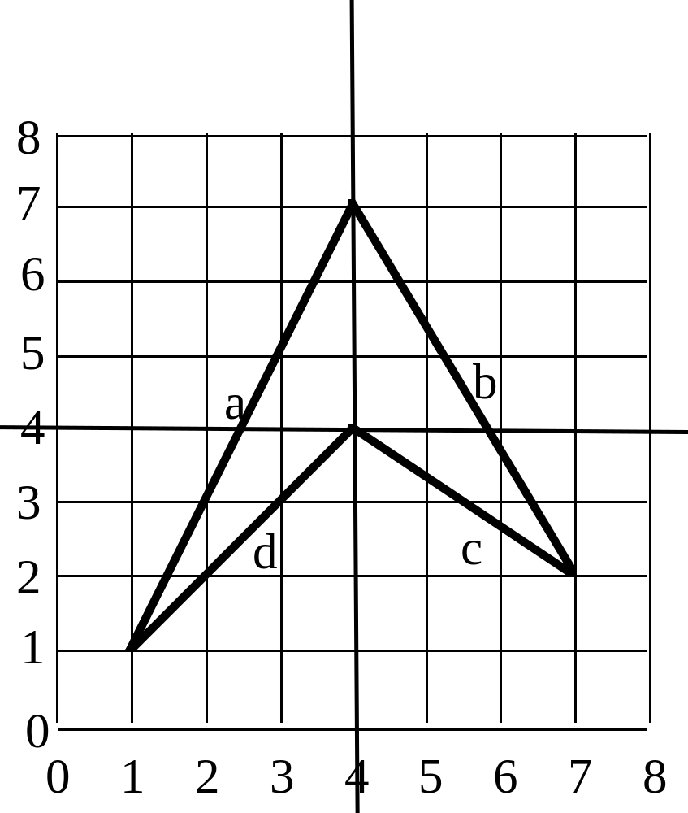
Example

Slide 25
Setup
Edges are
Edge Table Contains
Edge Label Coordinates y1 Structure
a (1,1) to (4,7) 1 (7,1,0.5)
b (7,2) to (4,7) 2 (7,7,-0.6)
c (7,2) to (4,4) 2 (4,7,-1.5)
d (1,1) to (4,4) 1 (4,1,1)
y1 Sequence of Edges
1 (7,1,0.5), (4, 1, 1)
2 (7,7,-0.6), (4, 7,-1.5)

Slide 26
On Each Line
Line Active Edge Table Spans
0 empty
1 (7,1,0.5), (4,1,1) 1 to 1
2 (7,1.5,0.5), (4,2,1), (4,7,-1.5), (7,7,-0.6) 1.5 to 2, 7 to 7
3 (7,2.0,0.5), (4,3,1), (4,5.5,-1.5), (7,6.4,-0.6) 2.0 to 3, 5.5 to 6.4
4 (7,2.5,0.5), (7,5.8,-0.6) 2.5 to 5.8
5 (7,3.0,0.5), (7,5.2,-0.6) 3.0 to 5.2
6 (7,3.5,0.5), (7,4.6,-0.6) 3.5 to 4.6
7 empty
8 empty

Slide 27
On Each Line
Line Active Edge Table Spans
0 empty
1 (7,1,0.5), (4,1,1) 1 to 1
2 (7,1.5,0.5), (4,2,1), (4,7,-1.5), (7,7,-0.6) 1.5 to 2, 7 to 7
3 (7,2.0,0.5), (4,3,1), (4,5.5,-1.5), (7,6.4,-0.6) 2.0 to 3, 5.5 to 6.4
4 (7,2.5,0.5), (7,5.8,-0.6) 2.5 to 5.8
5 (7,3.0,0.5), (7,5.2,-0.6) 3.0 to 5.2
6 (7,3.5,0.5), (7,4.6,-0.6) 3.5 to 4.6
7 empty
8 empty

